Slide 1
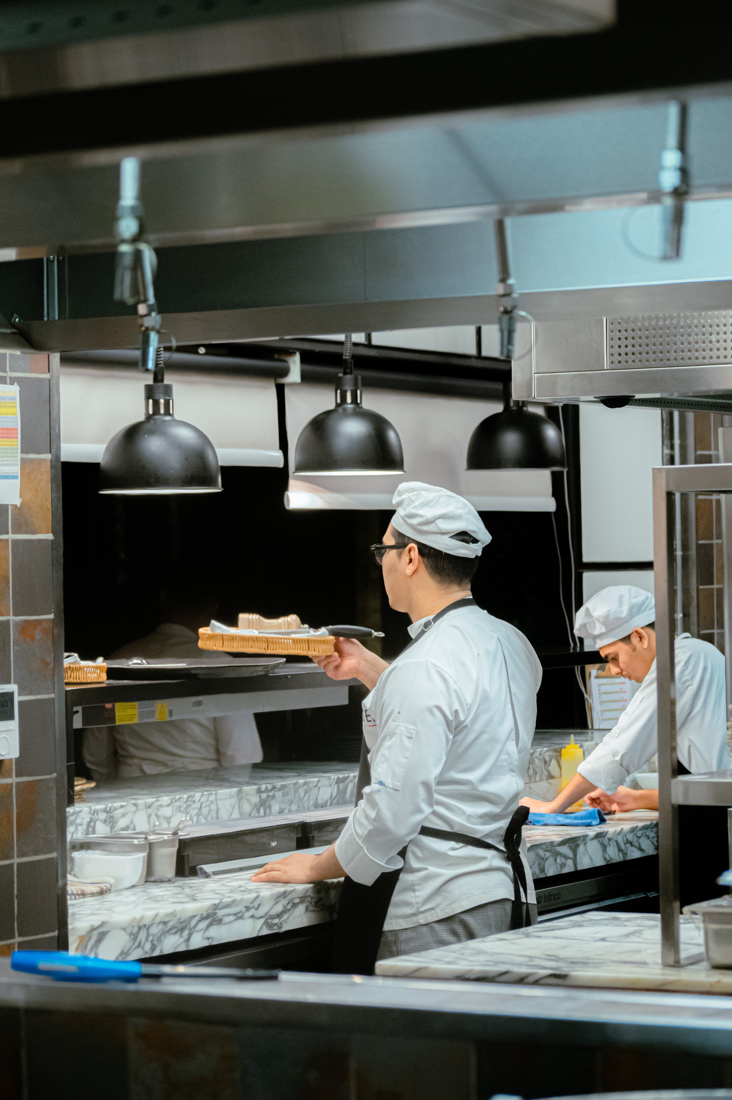


CUSTOMIZED AI KITCHEN FOR INDIA
Name: AJAY KUMAR MAHTO
Reg_no: 3502110506
Branch: CSE - A
amah4149@gmail.com

Slide 2

CONTENT
01
Overview
02
Objectives
03
Target Audience

Slide 3





OVERVIEW
Technology Used
Customized AI Kitchen for India is a web-based application designed to help users generate personalized recipes based on their specific preferences and available ingredients. Leveraging the power of React JS for the front-end and OpenAI for recipe generation, the platform aims to simplify meal planning and inspire culinary creativity. Users can input ingredients, select meal types, specify cuisine preferences, choose cooking time, and set the complexity level to receive tailored recipes that suit their needs.

Slide 4



OBJECTIVES
Personalized Recipe Generation
Integration with OpenA
Inspire Creativity:
Provide users with customized recipes that match their specific criteria, including available ingredients, meal types, cuisine preferences, cooking time, and complexity level.
Utilize OpenAI's powerful language model to generate detailed and accurate recipes that include step-by-step preparation and cooking instructions. easy navigation and interaction
Encourage users to experiment with new dishes and cooking techniques by providing innovative and diverse recipe suggestions.

Slide 5
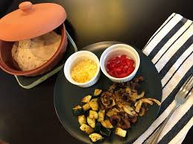

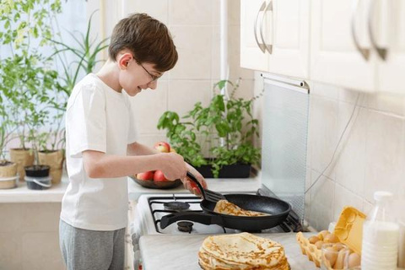
TARGET AUDIENCE
Home Cooks:
Individuals who enjoy cooking at home and are looking for new recipes to try, especially those who want to make the most of the ingredients they already have.
Customized AI Kitchen for India caters to home cooks looking for new recipe ideas, busy professionals needing quick meal solutions, and cooking enthusiasts eager to experiment with diverse cuisines. It also serves families seeking meals that satisfy varied preferences, health-conscious individuals aiming for nutritious options, and novice cooks needing simple, confidence-building recipes.
Health-Conscious Individuals
Users who are focused on healthy eating and want to find recipes that align with their dietary goals and preferences.
Novice Cooks
Beginners in the kitchen who need straightforward and simple recipes to build their confidence and cooking skills.

Slide 6


THANK YOU
FOR YOUR ATTENTION
July, 2024
amah4149@gmail.com

